Slide 1
Primitive Data Types and Operations
Amit Kr Mandal

Slide 2
Introduction
Introduce Programming with an Example
Identifiers, Variables, and Constants
Primitive Data Types
byte, short, int, long, float, double, char, boolean
Expressions
Operators, Precedence, Associativity, Operand Evaluation Order: ++, --, *, /, %, +=, -=, *=, /=, %=, ^, &, |, +, -,
Case Studies (Computing Mortgage, and Computing Changes)
Style and Documentation Guidelines
Syntax Errors, Runtime Errors, and Logic Errors

Slide 3
Identifiers
An identifier is a sequence of characters that consist of letters, digits, underscores (_), and dollar signs ($).
An identifier must start with a letter, an underscore (_), or a dollar sign ($). It cannot start with a digit.
An identifier cannot be a reserved word. (See Appendix A, “Java Keywords,” for a list of reserved words).
An identifier cannot be true, false, or null.
An identifier can be of any length.

Slide 4
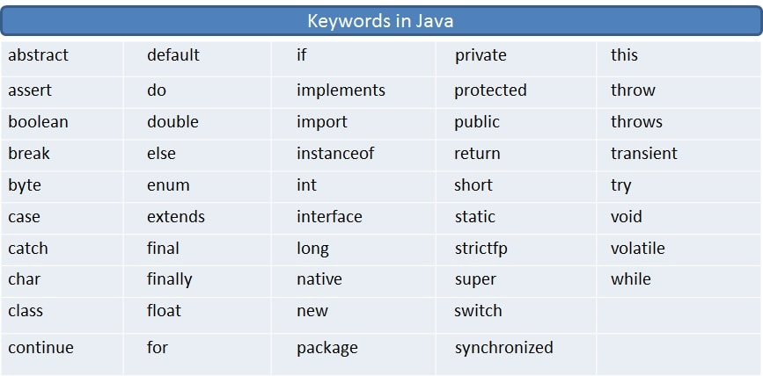
Appendix A, “Java Keywords”

Slide 5
Variables
// Compute the first area
radius = 1.0;
area = radius*radius*3.14159;
System.out.println("The area is “ + area + " for radius "+radius);
// Compute the second area
radius = 2.0;
area = radius*radius*3.14159;
System.out.println("The area is “ + area + " for radius "+radius);

Slide 6
Declaring Variables
int x; // Declare x to be an
// integer variable;
double radius; // Declare radius to
// be a double variable;
char a; // Declare a to be a
// character variable;

Slide 7
Assignment Statements
x = 1; // Assign 1 to x;
radius = 1.0; // Assign 1.0 to radius;
a = 'A'; // Assign 'A' to a;

Slide 8
Declaring and Initializing in One Step
int x = 1;
double d = 1.4;
float f = 1.4;
Is this statement correct?

Slide 9
Constants
final datatype CONSTANTNAME = VALUE;
final double PI = 3.14159;
final int SIZE = 3;

Slide 10
Numerical Data Types
byte 8 bits
short 16 bits
int 32 bits
long 64 bits
float 32 bits
double 64 bits

Slide 11
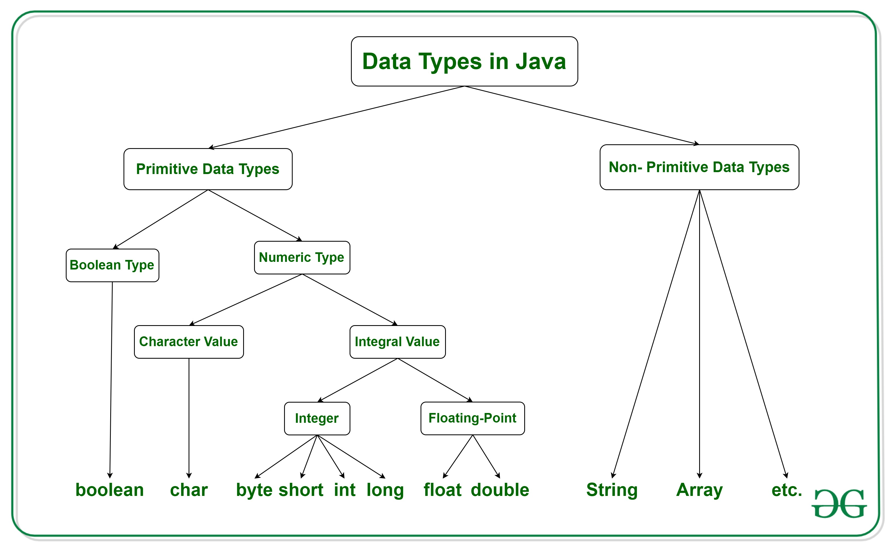
Data Types

Slide 12
Operators
+, -, *, /, and %
5/2 yields an integer 2.
5.0/2 yields a double value 2.5
5 % 2 yields 1 (the remainder of the division)

Slide 13
NOTE
Calculations involving floating-point numbers are approximated because these numbers are not stored with complete accuracy. For example,
System.out.println(1 - 0.1 - 0.1 - 0.1 - 0.1 - 0.1);
displays 0.5000000000000001, not 0.5, and
System.out.println(1.0 - 0.9);
displays 0.09999999999999998, not 0.1. Integers are stored precisely. Therefore, calculations with integers yield a precise integer result.

Slide 14
Number Literals
A literal is a constant value that appears directly in the program. For example, 34, 1,000,000, and 5.0 are literals in the following statements:
int i = 34;
long l = 1000000;
double d = 5.0;

Slide 15
Integer Literals
An integer literal can be assigned to an integer variable as long as it can fit into the variable. A compilation error would occur if the literal were too large for the variable to hold. For example, the statement byte b = 1000 would cause a compilation error, because 1000 cannot be stored in a variable of the byte type.
An integer literal is assumed to be of the int type, whose value is between -2³¹ (-2147483648) to 2³¹–1 (2147483647). To denote an integer literal of the long type, append it with the letter L or l. L is preferred because l (lowercase L) can easily be confused with 1 (the digit one).

Slide 16
Floating-Point Literals
Floating-point literals are written with a decimal point.
By default, a floating-point literal is treated as a double type value.
For example, 5.0 is considered a double value, not a float value.
You can make a number a float by appending the letter f or F, and make a number a double by appending the letter d or D.
For example, you can use 100.2f or 100.2F for a float number, and 100.2d or 100.2D for a double number.

Slide 17
Scientific Notation
Floating-point literals can also be specified in scientific notation, for example, 1.23456e+2, same as 1.23456e2, is equivalent to 123.456, and 1.23456e-2 is equivalent to 0.0123456. E (or e) represents an exponent and it can be either in lowercase or uppercase.

Slide 18
Arithmetic Expressions
is translated to
(3+4*x)/5 – 10*(y-5)*(a+b+c)/x + 9*(4/x + (9+x)/y)

Slide 19
Shortcut Assignment Operators
Operator Example Equivalent
+= i+=8 i = i+8
-= f-=8.0 f = f-8.0
*= i*=8 i = i*8
/= i/=8 i = i/8
%= i%=8 i = i%8

Slide 20
Increment and Decrement Operators

Slide 21
Increment and Decrement Operators, cont.

Slide 22
Increment and Decrement Operators, cont.
Using increment and decrement operators makes expressions short, but it also makes them complex and difficult to read. Avoid using these operators in expressions that modify multiple variables, or the same variable for multiple times such as this: int k = ++i + i.

Slide 23
Assignment Expressions and Assignment Statements
Prior to Java 2, all the expressions can be used as statements. Since Java 2, only the following types of expressions can be statements:
variable op= expression; // Where op is +, -, *, /, or %
++variable;
variable++;
--variable;
variable--;

Slide 24
Numeric Type Conversion
Consider the following statements:
byte i = 100;
long k = i*3+4;
double d = i*3.1+k/2;
int x = k; //(Wrong)
long k = x; //(fine,implicit casting)

Slide 25
Type Casting
double
float
long
int
short
byte

Slide 26
Type Casting, cont.
Implicit casting
double d = 3; (type widening)
Explicit casting
int i = (int)3.0; (type narrowing)
What is wrong? int x = 5/2.0;

Slide 27
Character Data Type
char letter = 'A'; (ASCII)
char numChar = '4'; (ASCII)
char letter = '\u0041'; (Unicode)
char numChar = '\u0034'; (Unicode)
Special characters
char tab = ‘\t’;

Slide 28
Unicode Format
Description Escape Sequence Unicode
Backspace \b \u0008
Tab \t \u0009
Linefeed \n \u000a
Carriage return \r \u000d

Slide 29
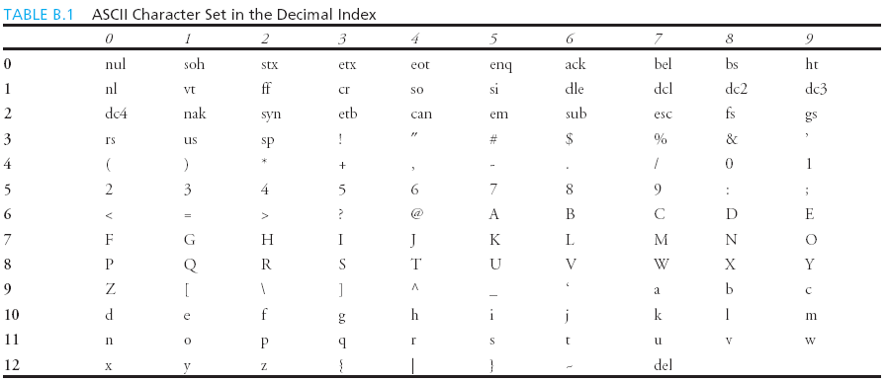
Appendix B: ASCII Character Set
ASCII Character Set is a subset of the Unicode from \u0000 to \u007f

Slide 30
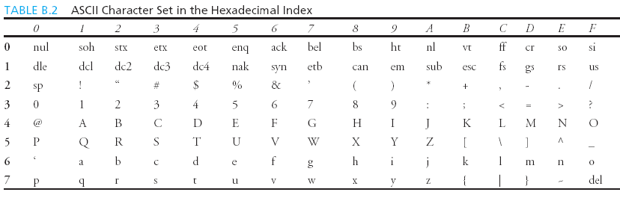
ASCII Character Set, cont.
ASCII Character Set is a subset of the Unicode from \u0000 to \u007f

Slide 31
Casting between char and Numeric Types
int i = 'a'; // Same as int i = (int)'a';
char c = 97; // Same as char c = (char)97;

Slide 32
The boolean Type and Operators
boolean lightsOn = true;
boolean lightsOn = false;
boolean b = (1 > 2);
&& (and) (1 < x) && (x < 100)
|| (or) (lightsOn) || (isDayTime)
! (not) !(isStopped)

Slide 33
Comparison Operators
Operator Name
< less than
<= less than or equal to
> greater than
>= greater than or equal to
== equal to
!= not equal to

Slide 34
Boolean Operators
Operator Name
! not
&& and
|| or
^ exclusive or

Slide 35
Truth Table for Operator !
Truth Table for Operator !
Operand !Operand
true false
false true

Slide 36
Truth Table for Operator &&
Operand1 Operand2 Operand1 && Operand2
false false false
false true false
true false false
true true true

Slide 37
Truth Table for Operator ||
Operand1 Operand2 Operand1 || Operand2
false false false
false true true
true false true
true true true

Slide 38
Truth Table for Operator ^
Operand1 Operand2 Operand1 ^ Operand2
false false false
false true true
true false true
true true false

Slide 39
The & and | Operators
&&: conditional AND operator
&: unconditional AND operator
||: conditional OR operator
|: unconditional OR operator
exp1 && exp2
(1 < x) && (x < 100)
(1 < x) & (x < 100)

Slide 40
The & and | Operators
If x is 1, what is x after this expression?
(x > 1) & (x++ < 10)
If x is 1, what is x after this expression?
(1 > x) && ( 1 > x++)
How about (1 == x) | (10 > x++)?
(1 == x) || (10 > x++)?

Slide 41
Operator Precedence
How to evaluate
3 + 4 * 4 > 5 * (4 + 3) - ++i

Slide 42
Operator Precedence
var++, var--
+, - (Unary plus and minus), ++var,--var
(type) Casting
! (Not)
*, /, % (Multiplication, division, and modulus)
+, - (Binary addition and subtraction)
<, <=, >, >= (Comparison)
==, !=; (Equality)
& (Unconditional AND)
^ (Exclusive OR)
| (Unconditional OR)
&& (Conditional AND) Short-circuit AND
|| (Conditional OR) Short-circuit OR
=, +=, -=, *=, /=, %= (Assignment operator)

Slide 43
Operator Associativity
When two operators with the same precedence are evaluated, the associativity of the operators determines the order of evaluation. All binary operators except assignment operators are left-associative.
a – b + c – d is equivalent to ((a – b) + c) – d
Assignment operators are right-associative. Therefore, the expression
a = b += c = 5 is equivalent to a = (b += (c = 5))

Slide 44
Operand Evaluation Order
The precedence and associativity rules specify the order of the operators, but do not specify the order in which the operands of a binary operator are evaluated. Operands are evaluated from left to right in Java.
The left-hand operand of a binary operator is evaluated before any part of the right-hand operand is evaluated.

Slide 45
Operand Evaluation Order, cont.
If no operands have side effects that change the value of a variable, the order of operand evaluation is irrelevant. Interesting cases arise when operands do have a side effect. For example, x becomes 1 in the following code, because a is evaluated to 0 before ++a is evaluated to 1.
int a = 0;
int x = a + (++a);
But x becomes 2 in the following code, because ++a is evaluated to 1, then a is evaluated to 1.
int a = 0;
int x = ++a + a;

Slide 46
Converting Strings to Integers
The input returned from the input dialog box is a string. If you enter a numeric value such as 123, it returns “123”. To obtain the input as a number, you have to convert a string into a number.
To convert a string into an int value, you can use the static parseInt method in the Integer class as follows:
int intValue = Integer.parseInt(intString);
where intString is a numeric string such as “123”.

Slide 47
Converting Strings to Doubles
To convert a string into a double value, you can use the static parseDouble method in the Double class as follows:
double doubleValue =Double.parseDouble(doubleString);
where doubleString is a numeric string such as “123.45”.

Slide 48
Example 2.2
A year is a leap year if it is divisible by 4 but not by 100, or it is divisible by 400.

Slide 49
Example 2.3 Computing Mortgages
This program lets the user enter the interest rate, number of years, and loan amount and computes monthly payment and total payment.

Slide 50
Example 2.4 Computing Changes
This program lets the user enter the amount in decimal representing dollars and cents and output a report listing the monetary equivalent in single dollars, quarters, dimes, nickels, and pennies. Your program should report maximum number of dollars, then the maximum number of quarters, and so on, in this order.

Slide 51
Programming Style and Documentation
Appropriate Comments
Naming Conventions
Proper Indentation and Spacing Lines
Block Styles

Slide 52
Appropriate Comments
Include a summary at the beginning of the program to explain what the program does, its key features, its supporting data structures, and any unique techniques it uses.
Include your name, class section, instruction, date, and a brief description at the beginning of the program.

Slide 53
Naming Conventions
Choose meaningful and descriptive names.
Variables and method names:
Use lowercase. If the name consists of several words, concatenate all in one, use lowercase for the first word, and capitalize the first letter of each subsequent word in the name. For example, the variables radius and area, and the method computeArea.

Slide 54
Naming Conventions, cont.
Class names:
Capitalize the first letter of each word in the name. For example, the class name ComputeArea.
Constants:
Capitalize all letters in constants. For example, the constant PI.

Slide 55
Proper Indentation and Spacing
Indentation
Indent two spaces.
Spacing
Use blank line to separate segments of the code.

Slide 56
Block Styles
Use end-of-line style for braces.

Slide 57
Programming Errors
Syntax Errors
Detected by the compiler
Runtime Errors
Causes the program to abort
Logic Errors
Produces incorrect result

Slide 58
Compilation Errors
public class ShowSyntaxErrors {
public static void main(String[] args) {
i = 30;
System.out.println(i+4);
}
}

Slide 59
Runtime Errors
public class ShowRuntimeErrors {
public static void main(String[] args) {
int i = 1 / 0;
}
}

